Slide 1
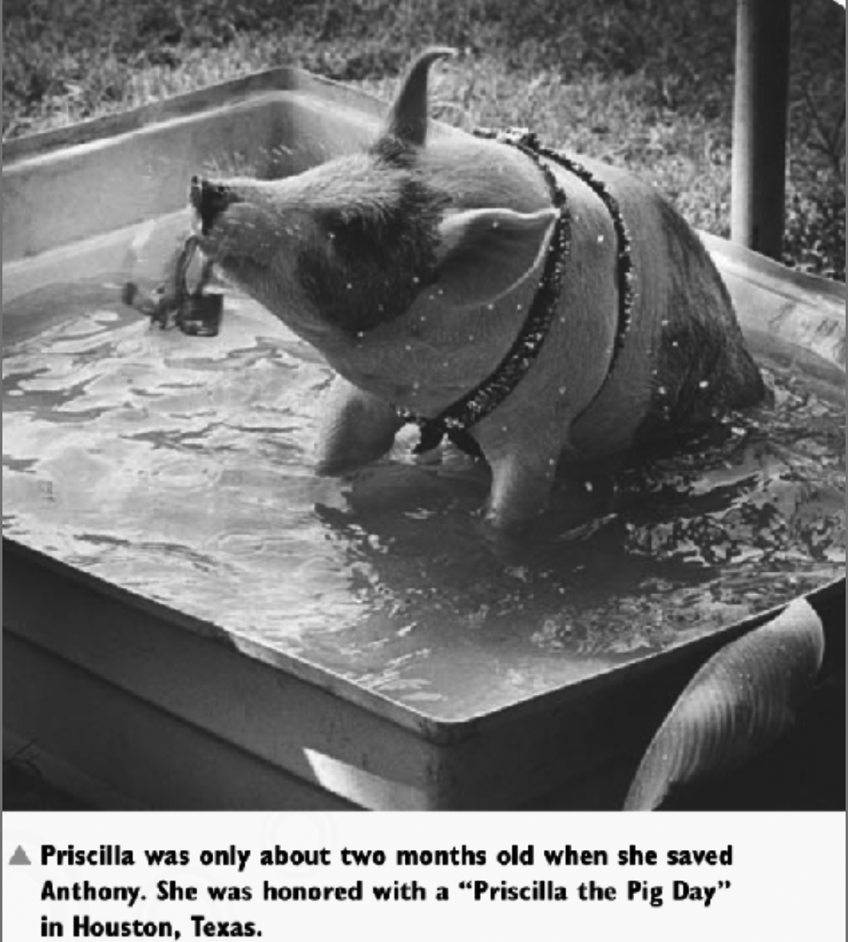

Slide 2
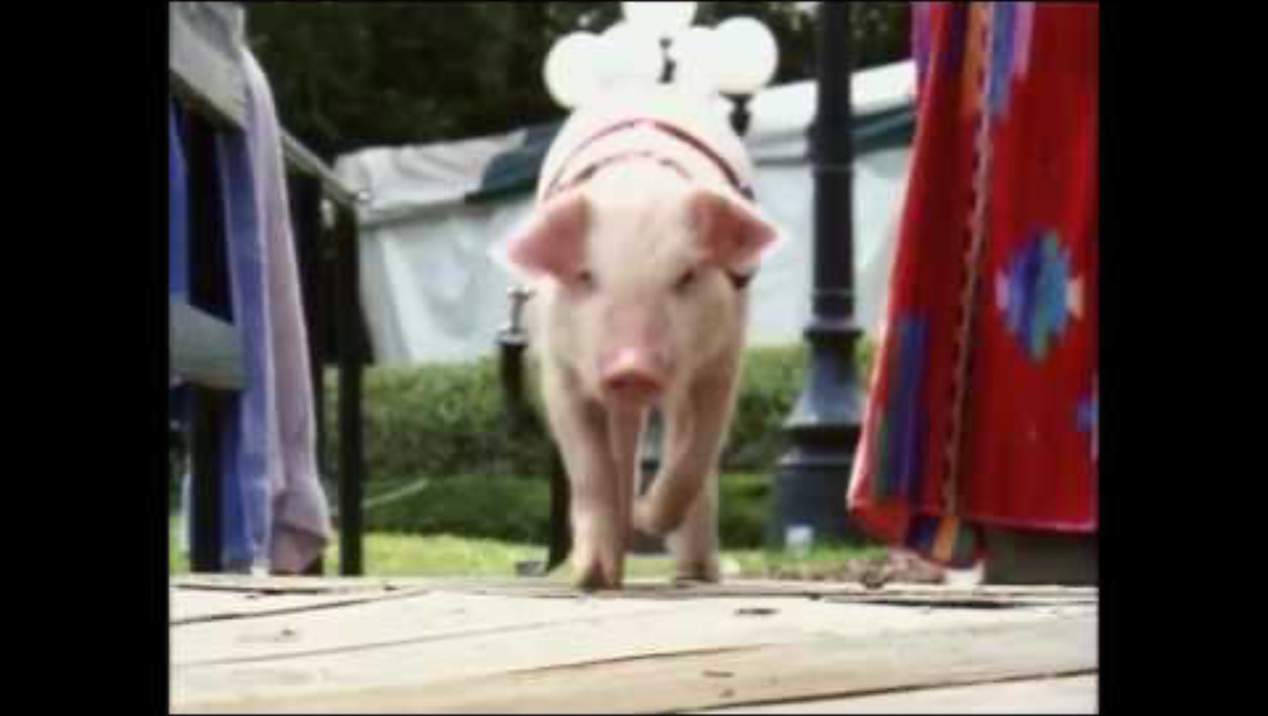
Priscilla to the rescue!
Notes:
Priscilla rescue recreation video (25 sec) on YouTube from Animal Voice South Africa
https://www.youtube.com/watch?v=BXOvwAeGDKQ

Slide 3
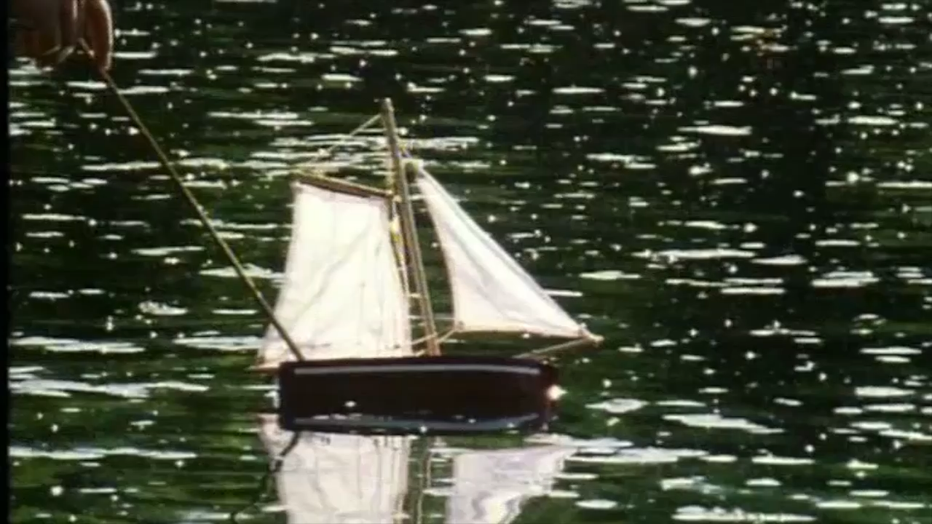
Priscilla to the rescue!
Notes:
49 sec version of the recreation video from CIWF Animals and Us video

Slide 4

Notes:
https://www.youtube.com/watch?v=IqXSjYCtScQ

Slide 5
